Slide 1

Customer Shopping Behavior Analysis
Analyzing 3,900 purchases to uncover spending patterns, preferences, and subscription behavior for strategic business decisions.

Slide 2

Project Overview & Dataset Summary
1
Project Goal
Uncover insights into spending patterns, customer segments, and product preferences.
2
Dataset Size
3,900 rows, 18 columns of transactional data.
3
Key Features
Demographics, purchase details, shopping behavior, subscription status.
4
Missing Data
37 values in Review Rating column.

Slide 3

Exploratory Data Analysis (Python)
Data Preparation & Cleaning
Data Loading: Imported dataset using pandas.
Initial Exploration: Checked structure and summary statistics.
Missing Data: Imputed Review Rating using median per category.
Standardization: Renamed columns to snake_case.
Feature Engineering: Created age_group and purchase_frequency_days.
Consistency Check: Dropped redundant promo_code_used.
Database Integration: Loaded cleaned data to MySQL for SQL analysis.

Slide 4
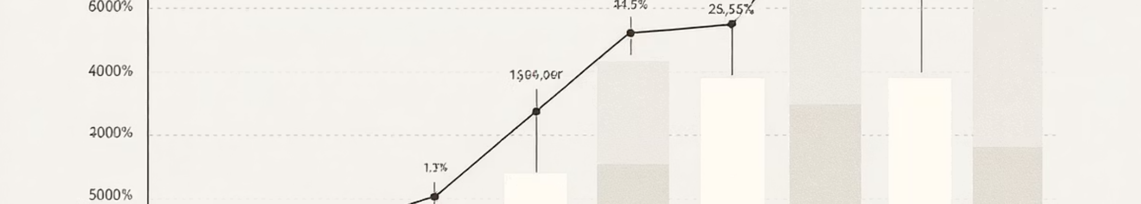


Data Analysis (SQL): Revenue Insights
Revenue by Gender
Revenue by Age Group
Male: $157,890
Young Adult: $62,143
Female: $75,191
Middle-Age: $59,197
Adult: $55,978
Senior: $55,763

Slide 5

Data Analysis (SQL): Product Performance
Top 5 Products by Rating
Top 3 Products per Category
Gloves: 3.86
Accessories: Jewelry, Sunglasses, Belt
Sandals: 3.84
Boots: 3.82
Clothing: Blouse, Pants, Shirt
Hat: 3.8
Footwear: Sandals, Shoes, Sneakers
Skirt: 3.78
Outerwear: Jacket, Coat

Slide 6

Data Analysis (SQL): Shipping & Discounts
Shipping Type Comparison
Discount-Dependent Products
Express: Avg. $60.48
Hat: 50.00%
Standard: Avg. $58.46
Sneakers: 49.66%
Coat: 49.07%
Sweater: 48.17%
Pants: 47.37%

Slide 7





Data Analysis (SQL): Customer Segmentation
Returning Customers
701 customers
New Customers
83 customers
Loyal Customers
3,116 customers

Slide 8
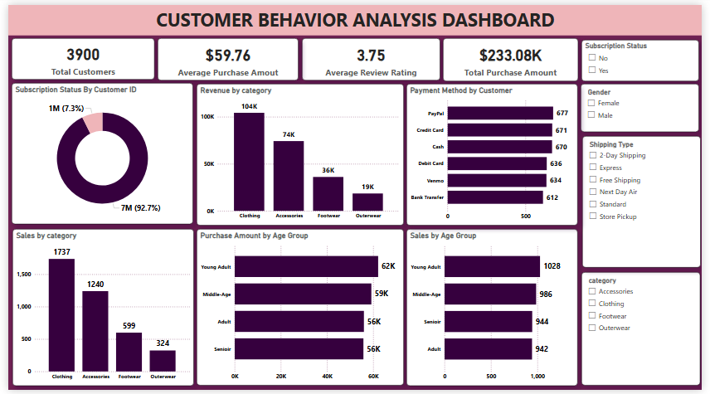
Interactive Dashboard in Power BI
Visualizing key insights for easy understanding.

Slide 9
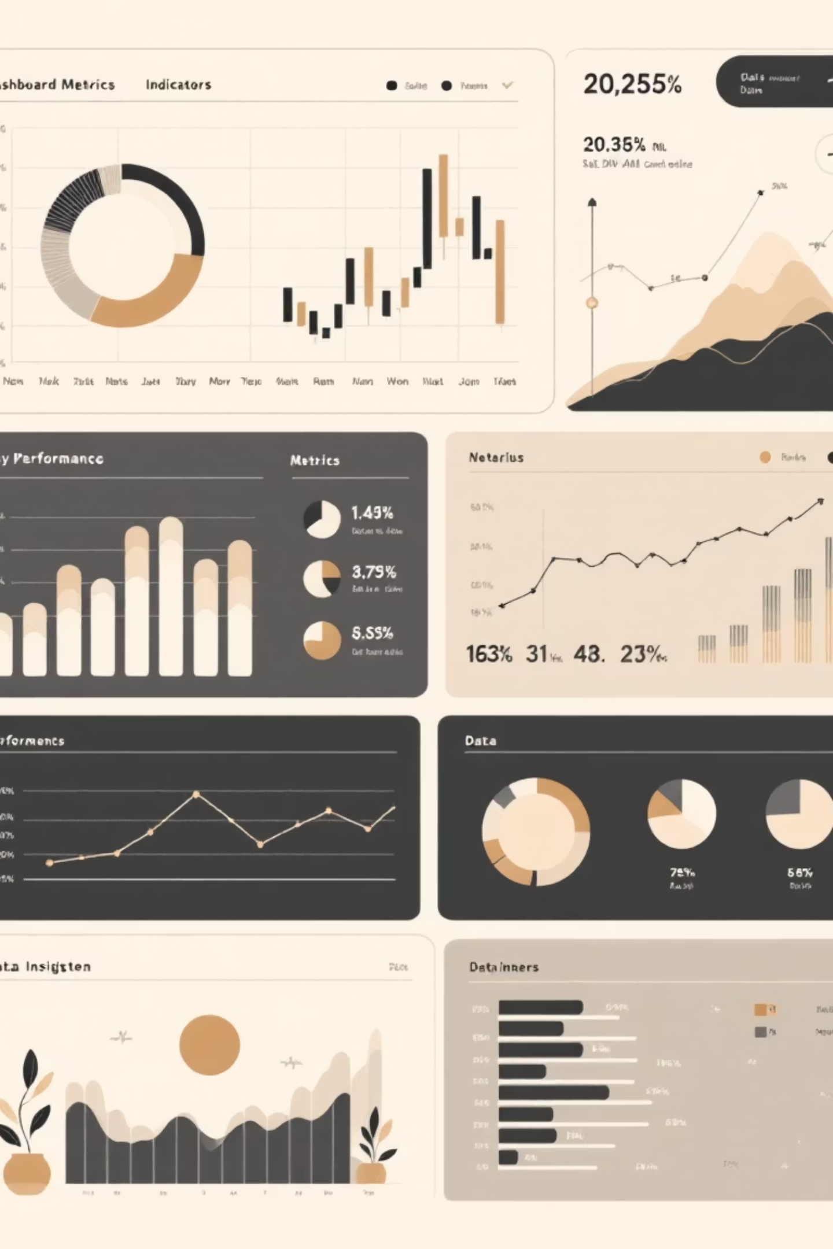
Dashboard Highlights
3900
$59.76
3.75
Total Customers
Avg. Purchase Amount
Avg. Review Rating
$233.08K
Total Purchase Amount

Slide 10





Business Recommendations
Boost Subscriptions
Promote exclusive benefits.
Customer Loyalty
Reward repeat buyers.
Review Discount Policy
Balance sales with margin.
Product Positioning
Highlight top-rated items.
Targeted Marketing
Focus on high-revenue groups.

